Slide 1
Christie’s Auction Events
--Web Scraping Project
Linlin Cheng
Linlin.cheng@nyu.edu
08/16/2016
NYC DataScience
Project Presentation III

Slide 2
Linlin Cheng | cheng@econ.umd.edu
Table of Contents:
I. Introduction
II. Website Structure and Methodology
III. Analysis
IV. Further Research
V. Questions

Slide 3
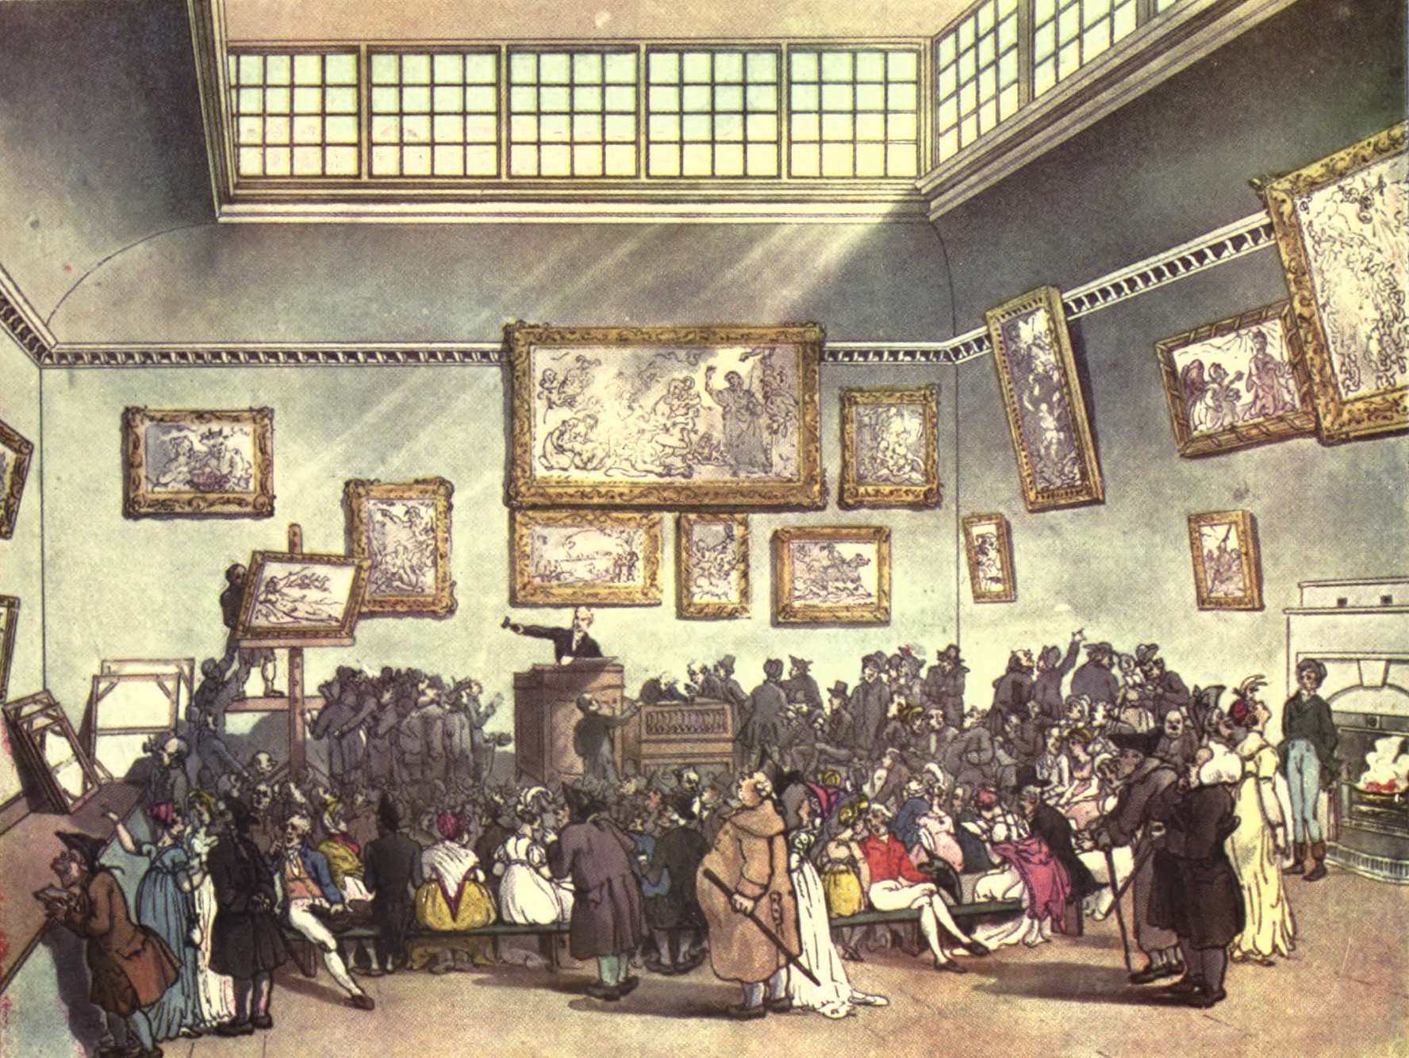
Introduction
Christie’s Auction House:
Founded in 1766 by James Christie
One of world’s leading auction house
Owned by Groupe Artémis
This project focuses on:
Building a database for Christie’s past auction events
Analyzing the global trend for sales by time and location
Image source:
https://en.wikipedia.org/wiki/File:Microcosm_of_London_
Plate_006_-_Auction_Room,_Christie%27s.jpg

Slide 4
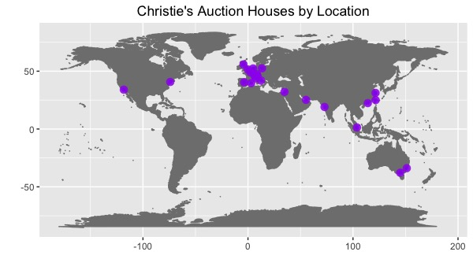
Christie’s Around the Globe

Slide 5
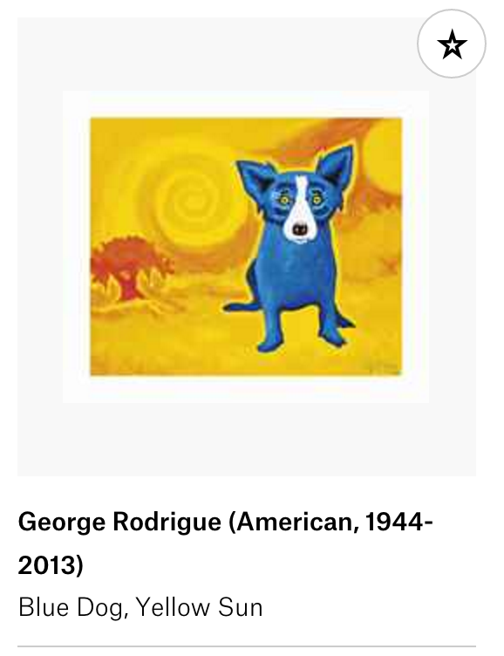
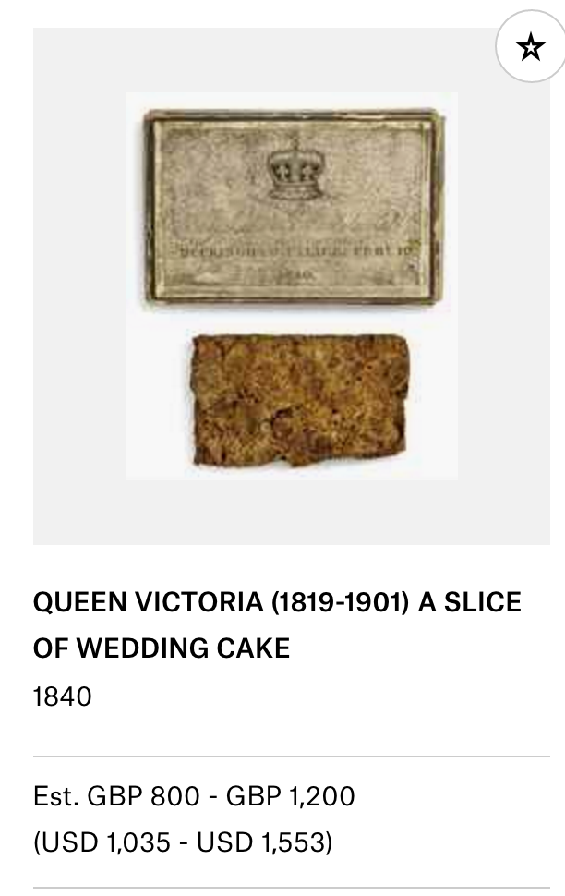
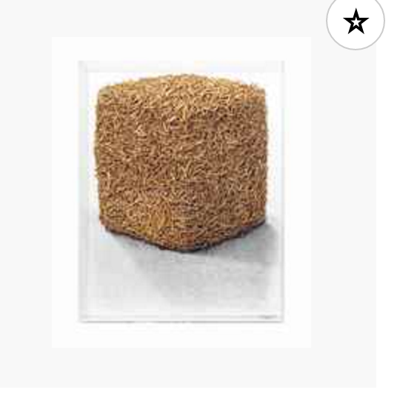
Christie’s sells all:
Fine and decorative art, jewelry, photographs, wine, and more…

Slide 6
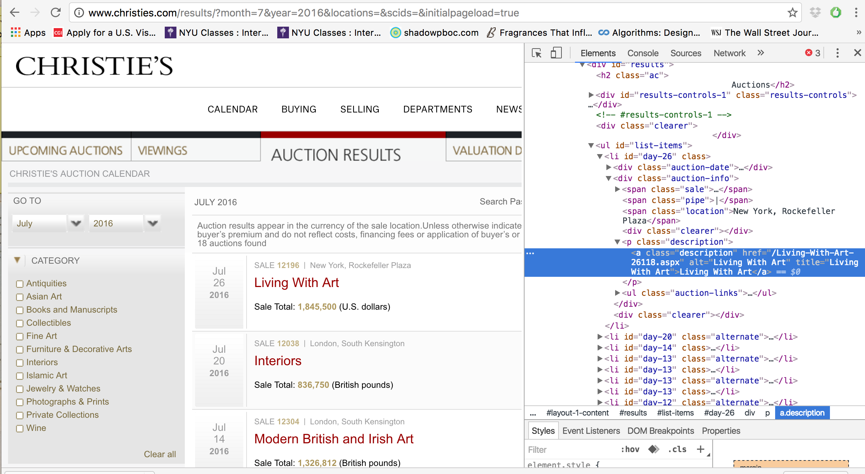
Data and Methodology
Notes:
73 columns and arounf 900, 000 row, which adds up to around 440 MB of data, whichh already takes quite a bit of time when loading into R
Recoded some of the others for the simplicity of the diagrams

Slide 7
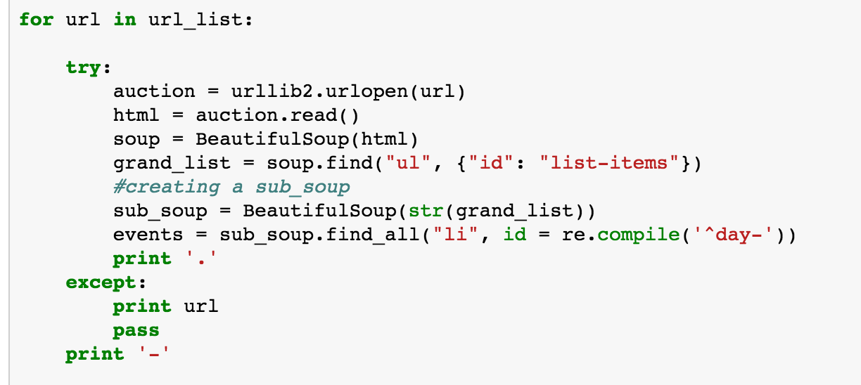
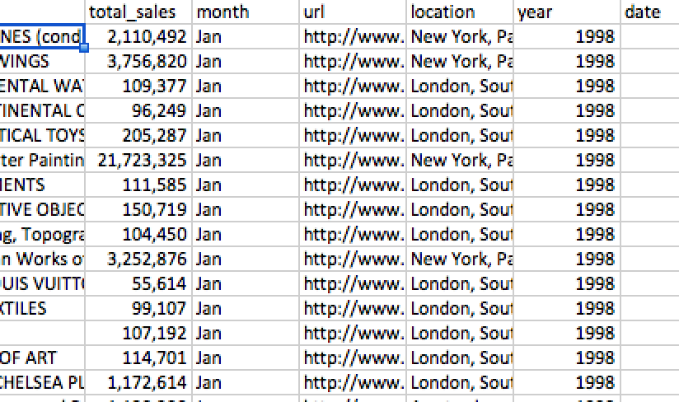
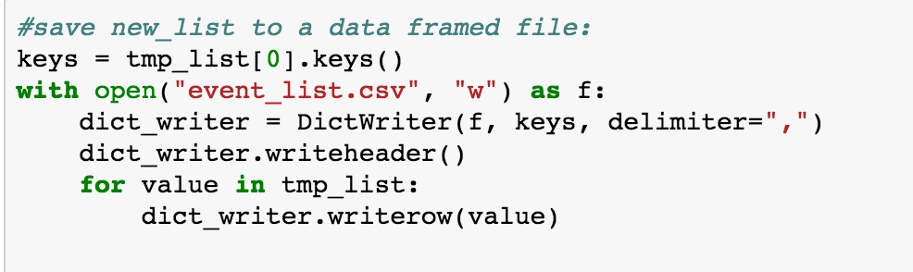

Slide 8
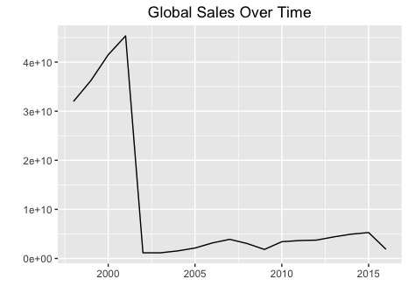
Global Sales Trend Over Time

Slide 9
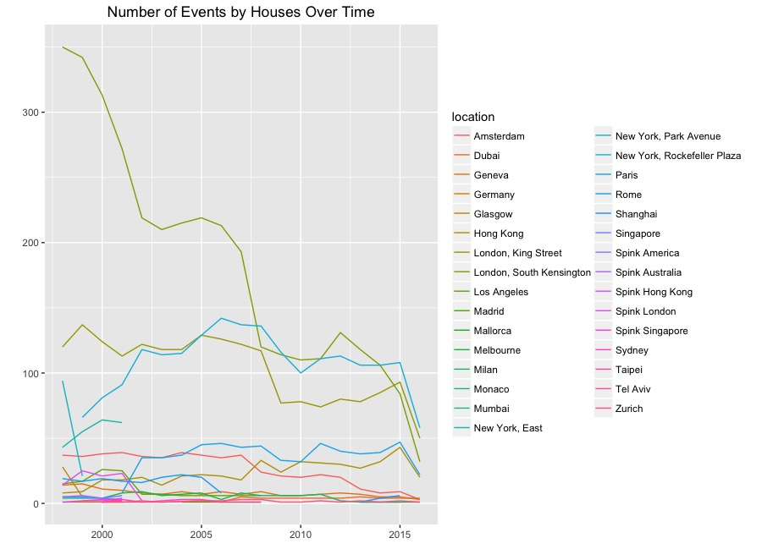
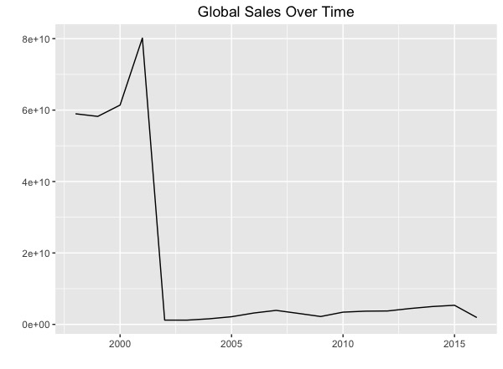
Global Sales Trend

Slide 10
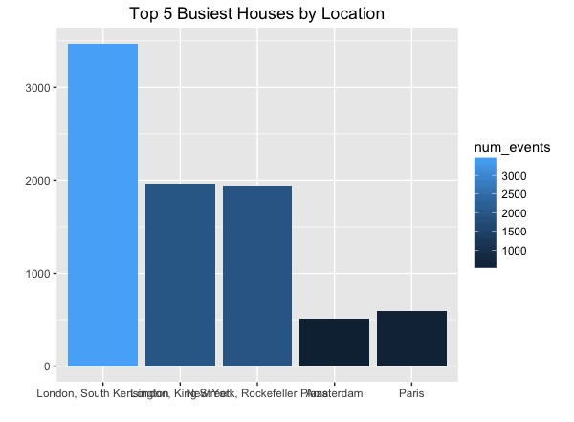
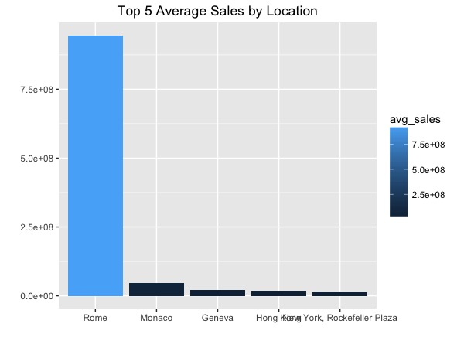

Slide 11
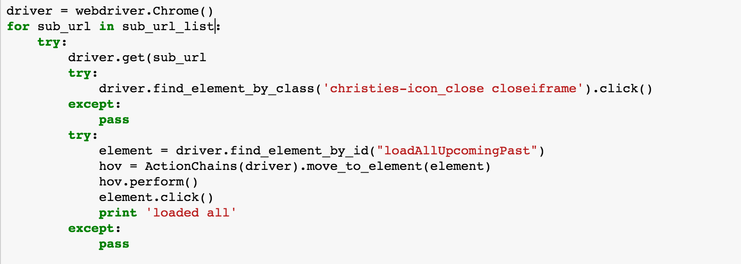
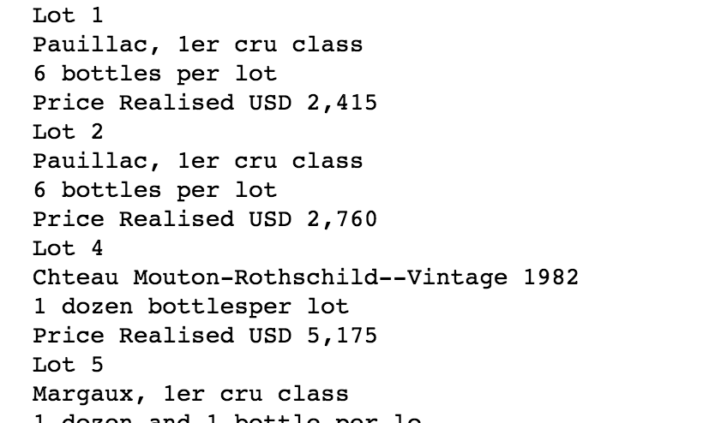
Further Research:
If given more time:
Look into specific events

Slide 12
Questions?

